Slide 1
RPS - Formulary Complete
Sprint 6 Planning

Slide 2
Agenda
Sprint 5 Deliverables’ Status
Sprint 5 Retrospective
Sprint 5 metrics
Project Status
Sprint 6 Plan
Sprint 6 Implementation Plan A
Sprint 6 Implementation Plan B (Contingency)
Change Requests
Risks & Impact
Questions?

Slide 3
Sprint 5 – Deliverables’ Status
User Story | Summary | Status | Remark
FC 47, 50 | • Reusable content creation | Incomplete | Development complete, pending System test. System tests could not be completed due to environmental issues impacting the sprint in its last week
FC 238 | • Review Changes | Incomplete
FC 276 | • Rendering Local Content | Incomplete
FC 274 | • IE 8 integration | Incomplete
FC 221 | • Exception Handling | Incomplete
FC 279 | • Migration | Ongoing will be completed in Sprint 6,7 | Migration strategy finalized. Design complete. Data migration was completed for Notes for drugs. System test pending

Slide 4
Sprint 5 – Deliverables’ Status
User Story | Summary | Status | Remark
FC 277 | • Manage Directories | Incomplete | Development complete, pending System test. Fully tested on local box and ready to be set to Done as soon as deployment is done on Cloud
FC 218 | • Monograph Template implementation | Incomplete
FC272 | • Split BNF and BNFC into separate indexes in Elasticsearch | Incomplete | With James
FC 147 | • Local record content creation: adding and editing fixed text | Complete
FC 279 | • Authentication | Complete
FC 230 | • Web design | Complete
FC 278 | • User Management | Complete

Slide 5
Sprint 5 – Impediment
Issue
Testing could not be done on Cloud since last week Thursday due to environmental issues.
Impact on the sprint deliverables, as stories even though developed could not be system tested.
Sprint 6 due to start yesterday was postponed by a day as developers could not work yesterday
Steps to resolve
Offshore team to get access to Azure and deployment rights
The environmental issues identified in previous sprint need to be picked up on priority and resolved as soon as possible in the current sprint

Slide 6
Sprint 5 – Retrospective
What Worked
Frequent check-ins, and prompt code reviews.
Refactoring Activities.
Ian’s visit.
The new functionality was coded for post high level design approval from Ian.
What can be improved
Release Process
Development and test environment.
Logging time in JIRA
Questions on functionalities to be asked earlier in the sprint.

Slide 7
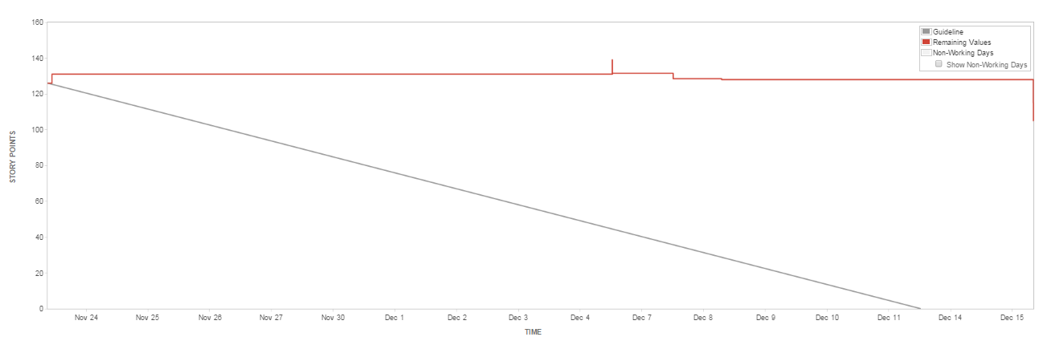
Sprint 5 – Metrics
Story points planned - 131 SP
Story points rolled over 105 SP (mostly pending testing)
27 SP was system tested and set to Done today (in 4 hrs of testing). Expecting similar trend to follow for remainder of testing.
Loss of almost 2.5 days of testing has impacted the sprint deliverables

Slide 8
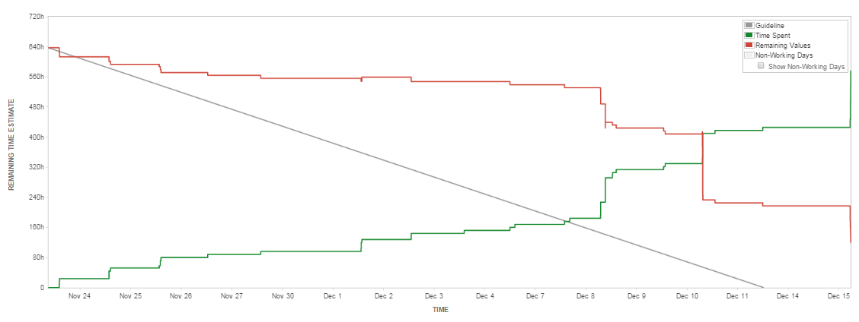
Sprint 5 – Metrics
Remaining effort left from Sprint 5 is 17 person days
In Story points it is equivalent to 21 SP rolled over to Sprint 6

Slide 9
Overall Project Status
Project Deliverables | Plan of Delivery | Revised Plan of Delivery | Remarks
User Accounts | Sprint 1 | Sprint 5 | Development complete, testing in progress.
Search Module | Sprint 2 | Sprint 5 | Re-factored Search module is tested. Development Pending for Search to include customer data , record titles. Technical impediment, in discussion with James
Edit the content: formulary status | Sprint 2 | Sprint 5 | Development complete, testing in progress.
Edit the local content | Sprint 2 | Sprint 4 | Development complete, testing in progress.
Edit Notes | Sprint 2 | Sprint 4
Monitor content changes: approval /workflow | Sprint 4 | Sprint 5 | Development complete, testing in progress.

Slide 10
Overall Project Status contd.
Project Deliverables | Plan of Delivery | Revised Plan of Delivery | Remarks
Monitor content changes: audit | Sprint 4 | Sprint 6
Export formulary content | Sprint 4 | Sprint 6 | These reports are still under discussion
Admin Module | Sprint 4 | Sprint 6
Drug Comparison | Sprint 5 |  | De-scoped (Comparison across drugs still in scope)
Annotation Search | Sprint 5 |  | De-scoped
View Changes across BNF versions | Sprint 5 | Sprint 6 | Reduced scope
Migration Activity | Sprint 3 onwards | Sprint 6,7 | Migration activity was initiated in sprint 5. To be continued in Sprint 6,7

Slide 11
Sprint 6 Plan
Tasks | Details | Remarks
Audit trail log of all admin actions | Only logging information in database, not generating report
Setting Formulary Status | Set for drug depending on breadcrumb Set for local records | Appearing of customer data on FC.
Changes for "Related info" | Show formulary Status, compare drugs etc.
Pending Work for search | Search by VTM or AMP id Search by record title (drugs, treatment summaries, preparations, interactions, borderline substances, wound management etc) Search for local records Search auto-complete for all relevant record types Design and build search results page | Add-on to existing Search functionality.

Slide 12
Sprint 6 Plan
Tasks | Details | Remarks
Migration Activity (To be continued) | Customer data to be migrated from PostgreSQL to Elastic Search
Complete pending development and testing for Sprint 5 Roll over work | All Pending Testing to be completed.
Managing Directories | New Functionality for FC. Directories to be introduced for publications BNF and BNFC | This is a “change” that will be picked up in Sprint 6

Slide 13
Sprint 6 Plan - A
All spare capacity will be used for stabilizing the code, regression testing etc.

Slide 14
Sprint 6 Plan – B (contingency)
Plan B has additional testing resources added, if required to complete testing for migration
This plan will come into play if there is a risk identified by 24th December
All spare capacity will be used for stabilizing the code, regression testing etc.

Slide 15
Definition of Done
Definition of Done will be the System Test Cases as approved by RPS

Slide 16
Change Requests
Not Applicable

Slide 17
Risks & Impact
Non Stable Development and Test environment – The delay caused due to environmental issues can impact deliverables..
Mitigation
Environment issues identified in previous sprint are to be resolved on priority.
Multiple meetings if required to iron out open issues.
Contingency
Impact
Budget and Schedule

Slide 18
Risks & Impact contd.
Turnaround time for clarifications – Clarifications if not answered at the earliest could impact on the deliverables/ cause rework.
Mitigation
Rave to proactively share list of clarifications with RPS periodically.
RPS to reply to clarifications with a one day turnaround time to minimize the impact on the deliverables and avoid rework.
Contingency
Rave to continue development making assumptions
Impact
Idle Time, Budget and Schedule

Slide 19
Risks & Impact contd.
Not following coding best practices – Code not following best practices, leads to Refactoring of code. This causes rework and impacts deliverables.
Mitigation
Peer review before checking-in code.
Ensuring the issues identified in earlier review are not repeated.
Contingency
Impact
Budget and Schedule

Slide 20
Risks & Impact contd.
Delay in finalizing web design – The delay in not getting a sign-off early into the sprint can impact deliverables..
Mitigation
Quick response from RPS on proposed changes by web design team
Multiple meetings if required to iron out open issues.
Discussion of design before working on a new module.
Contingency
Impact
Budget and Schedule

Slide 21
Questions?

